Slide 1

INTRODUCTION TO ARTIFICAL INTELLIGENCE
TERM PROJECT – PROPOSAL
IMPLEMENTAION OF REINFORCEMENT LEARNING AGENT ON A SNAKE GAME
TEAM MEMBER: SASIDHAR REDDY KATIKAM
NAGA VENKATA SAITEJA KEERTY
SOMA DIVYA

Slide 2
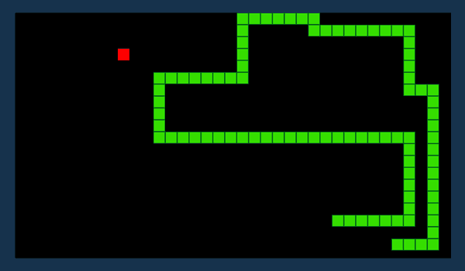
IMPLEMENTAION OF A REINFORCEMENT LEARNING AGENT ON A SNAKE GAME
PROJECT OBJECTIVE :
We use the reinforcement learning mechanism on an existing video game (snake game).
Here, The goal is to create a Reinforcement Learning agent to make an optimal decision in the closed environment to get the highest reward.
In this environment, it has incomplete information, and the state space of agents are quite large, We need to deal with these hurdles.
The snake game starts with a dot, the main aim is to collect more dots and goes on increasing the size.
It moves with one dot at a time that is either left, right or straight and the game ends when the snake collides with it’s own body or with the edge(wall)

Slide 3
OBJECTIVES
OBSTACLES
Maximize cumulative reward: The RL agent's objective is to learn a policy that maximizes its long-term cumulative reward.
Explore and exploit: The RL agent must balance exploration and exploitation to find the optimal policy.
Adapt to changing environments: The RL agent must be able to adapt to changes in its environment.
ENVIRONMENT SPACE AND STATE
ACTION SPACE
REWARDS

Slide 4


APPROACH
Pytorch - Its a widely used open-source machine learning framework used for various applications, developed by the Facebook AI research team.
Numpy - It is a library for python programming language, which is used to perform large variety of mathematical functions to operate on array. It frees up the memory faster so that the overall task executes faster.
Pygame - It is an open-source cross platform library intended for writing video games and other multimedia applications. It can run on various operating systems and platforms.

Slide 5
DELIVERABLES
Algorithms developed to train agents using programming.(.py files)
Documentation manual mentioning about game implementation about various models.
Presentation on project overview.
YouTube link demonstrating the game implementation
GitHub link for the project

Slide 6
EVALUATION METHODOLOGY
Cumulative Reward: Measures the total sum of rewards received by the agent over a period of time.
Success Rate: Measures the percentage of episodes or trials in which the agent achieves its objective.
Average Reward: Measures the cumulative reward divided by the number of time steps or episodes.
Learning Curve: Plots the average or cumulative reward against the number of episodes or time steps.

Slide 7
SNAKE GAME SAMPLE DEPLOYMENT

Slide 8
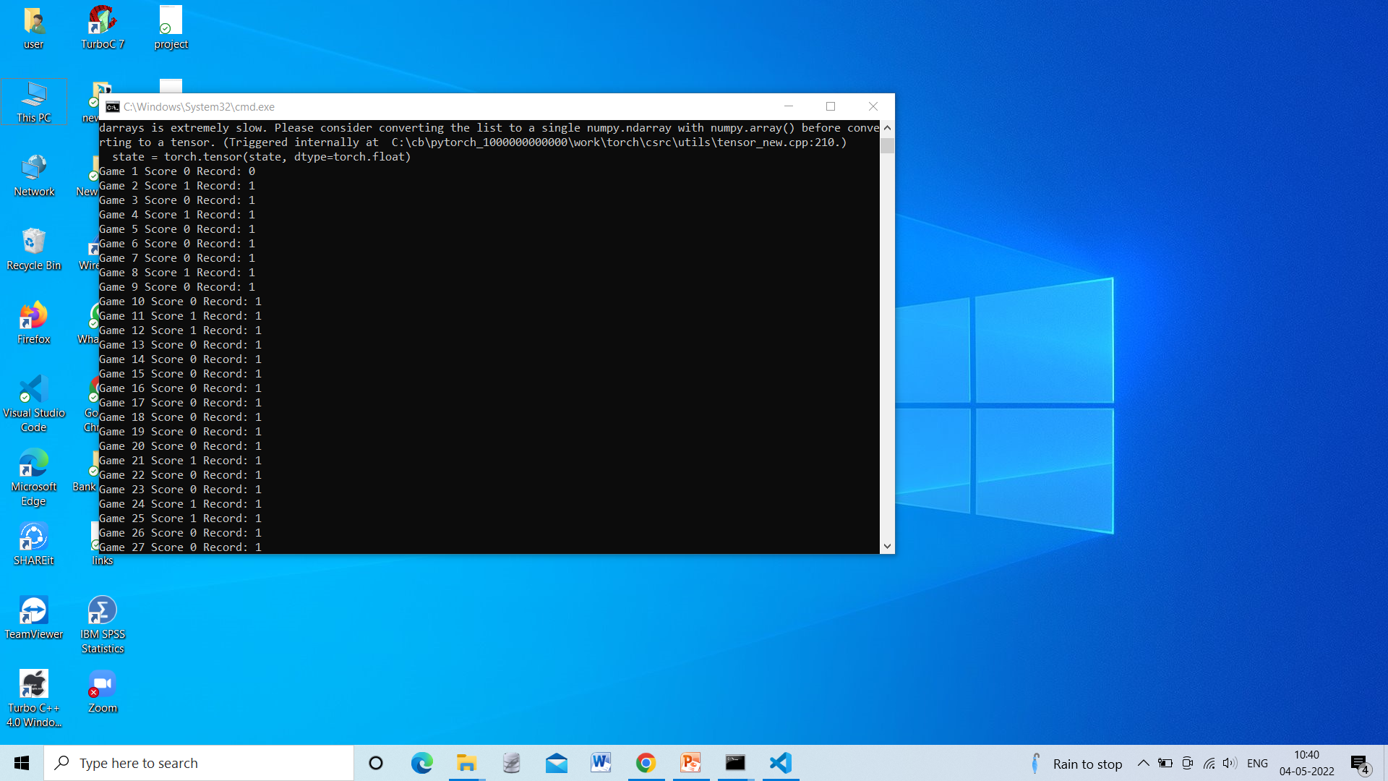
RESULTS

Slide 9
CONCLUSION
Based on the parameter values we have chosen. We found to see how the agent would perform over a 1000 games compared with the default values we have taken. These experiments are conducted to find the optimal values to make our RL agent more efficient than that of default values.
Learning rate, epsilon and gamma parameters had the biggest impact on the performance.
The other parameters like food distance, direction and food generation were detrimental to the experiment.

Slide 10


